Slide 1

Deep Dive into Bouncy Castle: Java Cryptography Made Practical
Welcome to a comprehensive exploration of Bouncy Castle, an essential library for Java cryptography. This presentation will guide you through its core functionalities, practical applications, and best practices for securing your Java applications.

Slide 2
What is Bouncy Castle?
Bouncy Castle is a robust, open-source Java cryptography API that provides a vast array of cryptographic algorithms and protocols. It extends the standard Java Cryptography Extension (JCE), filling gaps and offering advanced features not natively available. Trusted by developers worldwide, it's a cornerstone for building secure Java applications.
1
2
Comprehensive Coverage
JCE Complement
Supports a wide range of algorithms including AES, RSA, ECC, and protocols like PGP, CMS, and X.509 certificates.
Acts as a provider for JCE, allowing seamless integration with Java's built-in security architecture.
3
4
Open Source & Widely Adopted
Cross-Platform
Free to use and backed by a large, active community, making it a reliable choice for production systems.
Designed to work across various Java environments and platforms, ensuring broad compatibility.
For more details, visit the official website: https://www.bouncycastle.org/

Slide 3
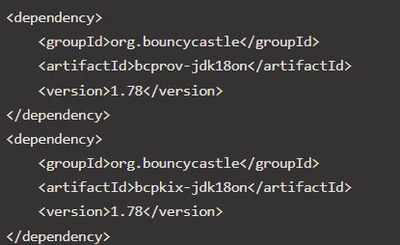
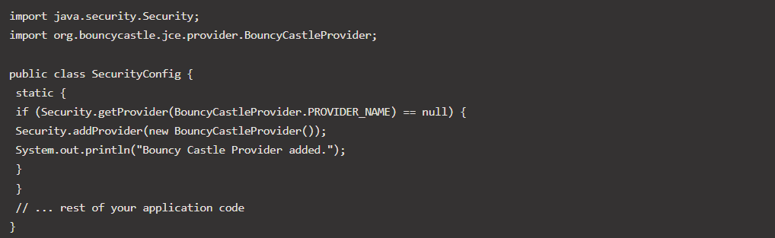
Setting Up Bouncy Castle in Your Java Project
Integrating Bouncy Castle into your Java project is straightforward, typically involving adding the necessary Maven or Gradle dependencies. It's crucial to select the correct version to ensure compatibility and access to the latest features and security updates.
Maven Dependency
Gradle Dependency
implementation 'org.bouncycastle:bcprov-jdk18on:1.78‘
implementation 'org.bouncycastle:bcpkix-jdk18on:1.78'
These dependencies provide the core cryptographic provider (bcprov-jdk18on) and the PKIX/CMS (Public Key Infrastructure / Cryptographic Message Syntax) classes (bcpkix-jdk18on), essential for handling certificates and signed messages.
It's also good practice to register Bouncy Castle as a security provider programmatically at the start of your application, ensuring it's available for all cryptographic operations.

Slide 4
Symmetric Encryption with AES
AES (Advanced Encryption Standard) is one of the most widely used symmetric encryption algorithms. Bouncy Castle simplifies its implementation, allowing you to encrypt and decrypt sensitive data securely using a single key.
This example demonstrates AES in CBC (Cipher Block Chaining) mode with PKCS7 padding. Key and IV (Initialization Vector) management are critical for security; they should never be hardcoded in a real application.
Key Size: AES supports 128, 192, and 256-bit keys.
IV: Must be unique for each encryption, but does not need to be secret.
Padding: Ensures the plaintext always fits block size requirements.

Slide 5
Asymmetric Encryption with RSA
RSA is a widely used asymmetric encryption algorithm, crucial for secure key exchange and digital signatures. Bouncy Castle provides comprehensive support for RSA key generation, encryption, and decryption, leveraging its robust mathematical primitives.
The power of RSA lies in its public-private key pair. Data encrypted with the public key can only be decrypted with the corresponding private key, and vice versa for digital signatures. This asymmetry is fundamental to modern secure communications.
Key Pairs: Generate unique public and private keys.
Encryption: Use the public key to encrypt data.
Decryption: Use the private key to decrypt data.

Slide 6
Hashing and Digital Signatures
Hashing and digital signatures are fundamental to ensuring data integrity and authenticity. Bouncy Castle provides robust implementations for various hash functions (e.g., SHA-256) and digital signature algorithms (e.g., DSA, ECDSA, RSA with SHA).
A digital signature binds a person or entity to digital data, ensuring that the data has not been altered since it was signed and proving the signer's identity. It relies on asymmetric cryptography.
Hashing: Creates a fixed-size digest of the data.
Signing: Encrypts the hash with the sender's private key.
Verification: Decrypts with the sender's public key and compares hashes.

Slide 7
Working with X.509 Certificates
X.509 certificates are digital documents that bind a public key to an individual or entity, issued by a Certificate Authority (CA). Bouncy Castle provides extensive capabilities for creating, parsing, and validating X.509 certificates, which are fundamental to TLS/SSL and secure communication.
Understanding certificate structures and their fields is crucial for secure application development. Bouncy Castle simplifies handling these complex structures, from generating self-signed certificates for testing to parsing intricate certificate chains.
Key Components: Public key, identity information, issuer, validity period, digital signature.
Certificate Chains: Trust is established through a chain of certificates leading back to a trusted root CA.
Use Cases: Server authentication, client authentication, code signing, email encryption.

Slide 8
Password-Based Cryptography (PBE)
Password-Based Encryption (PBE) allows cryptographic operations to be derived from a human-memorable password. Bouncy Castle offers implementations for various PBE algorithms, commonly used in PKCS#12 keystores and encrypted files, providing a way to secure data without managing complex key files directly.
PBE adds a layer of convenience but requires careful consideration of password strength, salt uniqueness, and iteration counts to resist brute-force attacks.
Password: User-provided secret for deriving the encryption key.
Salt: Random data combined with the password to prevent precomputed attacks (rainbow tables).
Iteration Count: Number of times the hashing function is applied, increasing the computational cost of brute-force attacks.

Slide 9
Best Practices for Bouncy Castle Implementation
Implementing cryptography correctly is paramount for security. Even with a powerful library like Bouncy Castle, misconfigurations can lead to vulnerabilities. Adhering to best practices ensures your applications are robust and resilient against attacks.
Always Register the Provider
Ensure Security.addProvider(new BouncyCastleProvider()) is called once at application startup.
Secure Key Management
Never hardcode keys or IVs. Use secure key stores (e.g., JKS, PKCS#12), hardware security modules (HSMs), or robust key derivation functions.
Choose Appropriate Algorithms & Modes
Stay updated on recommended algorithms (e.g., AES-256) and secure modes (e.g., GCM for authenticated encryption). Avoid deprecated or weak algorithms.
Handle IVs and Salts Correctly
Generate unique and random IVs for each symmetric encryption operation and unique salts for each PBE key derivation. Store them with the ciphertext, but not secretly.
Error Handling & Logging
Implement robust error handling for cryptographic operations and avoid logging sensitive data or error details that could aid attackers.
Stay Updated
Regularly update Bouncy Castle to the latest version to benefit from bug fixes, performance improvements, and security patches.
Validate Inputs
Always validate and sanitize inputs to prevent injection attacks and ensure cryptographic functions receive expected data formats.

Slide 10



Key Takeaways & Next Steps
Bouncy Castle is an invaluable tool for Java developers needing to implement robust cryptographic functionalities. Its comprehensive suite of algorithms and protocols empowers you to build highly secure applications.
Empower Your Security
Bouncy Castle extends Java's cryptographic capabilities, offering a wide range of algorithms for encryption, hashing, and digital signatures.
Seamless Integration
As a JCE provider, it integrates smoothly into existing Java security architectures, making adoption straightforward.
Focus on Best Practices
Always prioritize secure key management, algorithm selection, and proper implementation to avoid common cryptographic pitfalls.
Thank you for joining this deep dive into Bouncy Castle. Secure coding is an ongoing journey!

